Slide 1
PowerPoint 1:
Images of
bank notes
Lesson 1-1

Slide 2
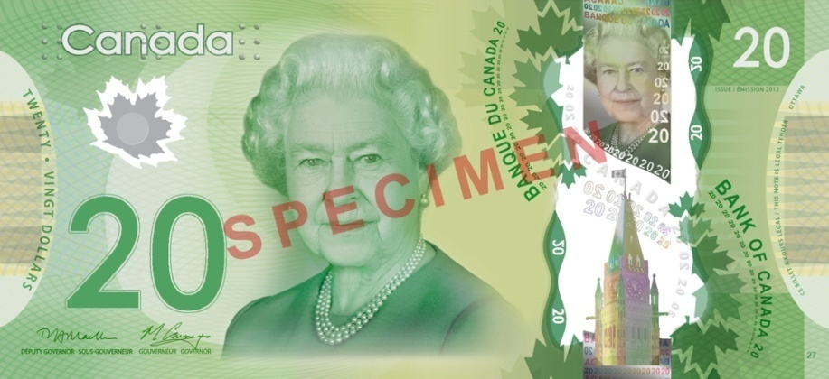
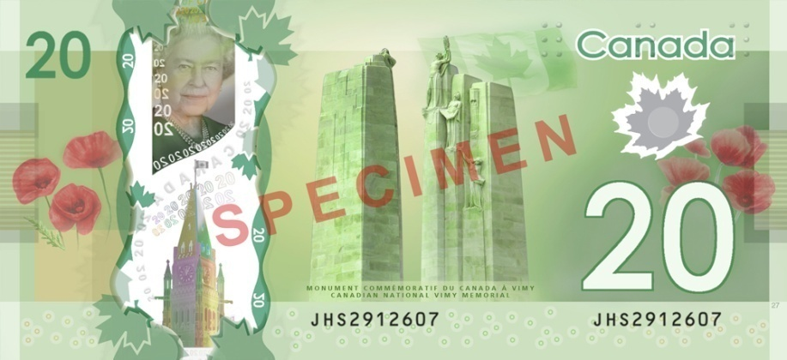
Polymer series

Slide 3

Polymer series

Slide 4

Polymer series

Slide 5
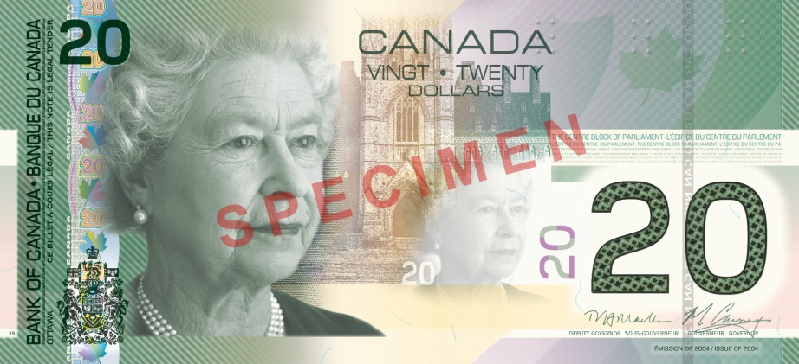
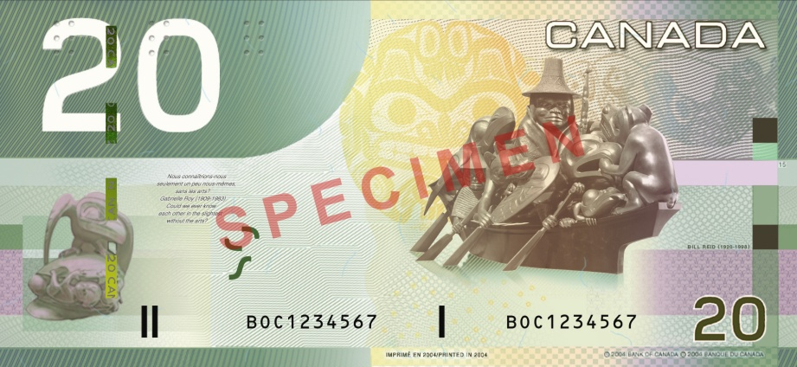
Canadian Journey series

Slide 6

Canadian Journey series

Slide 7

Canadian Journey series

